Slide 1
Artificial Selection
Selective Breeding and Evolution
Mr. Erdosy
Cedar School
2010

Slide 2
What is Artificial Selection?
It is also called Selective Breeding.
Selective Breeding is when humans select which organisms in a group will be allowed to reproduce.
They make their choice based on which traits they would like to be passed on to the offspring.

Slide 3
Why do humans do it?
Humans practice Selective Breeding in order to create organisms that we desire or can use.
Examples include horses, cows, dogs, cats, crops and many other living things.

Slide 4
How does it work?
Traits or characteristics are passed on from generation to generation.
Selecting the individuals in a population that have those traits, and only allowing those individuals to breed, guarantees those traits will be in the next generation.

Slide 5
Teosinte
Teosinte is a grass that was selectively bred over thousands of years to increase the number of seeds it produces.
To do this, humans only allowed the Teosinte plants with the most seeds to reproduce with each other. This made sure that the seeds would grow into plants with more seeds than before.

Slide 6
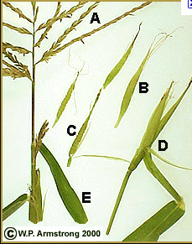
Teosinte
Over the generations, Teosinte was transformed into…

Slide 7
CORN

Slide 8
There are hundreds of different types of corn today.
Every single one of them was Selectively Bred, on purpose, by humans.

Slide 9
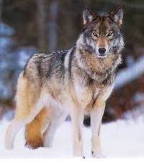
Dogs
Every domesticated dog alive can be traced, very easily, back to a population of Grey Wolves.

Slide 10
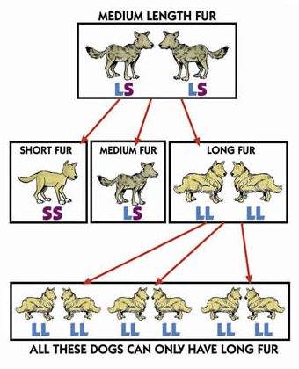
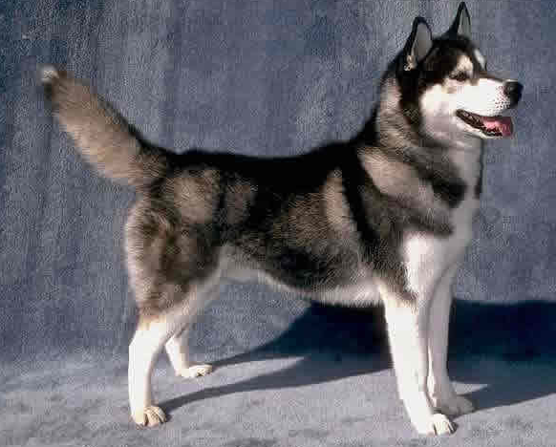
Selective Breeding of Wolves
Wolves with certain traits were only allowed to reproduce with wolves with other certain traits.
Over many generations, different variations of this creature were isolated.

Slide 11
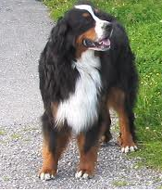
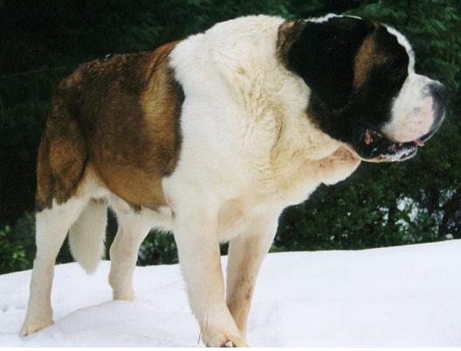

Slide 12
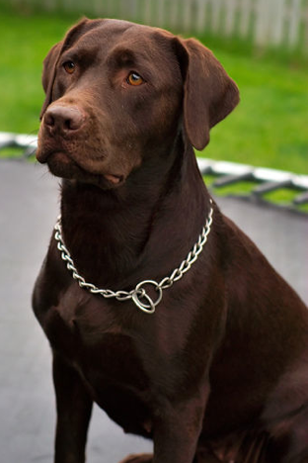
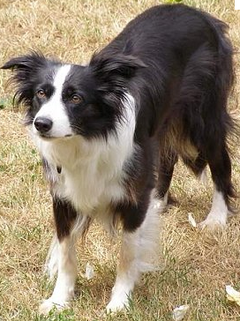

Slide 13
All dogs are just different varieties of the same species.

Slide 14
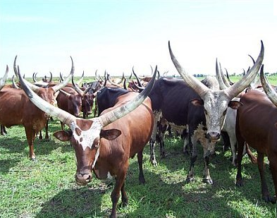
Cattle
All domesticated cattle have been Selectively Bred from the Aurochs.

Slide 15
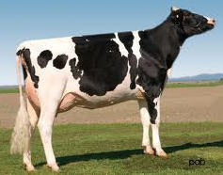
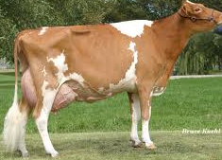
Milk Producers

Slide 16
Black Angus Beef

Slide 17
The Belgian Blue

Slide 18
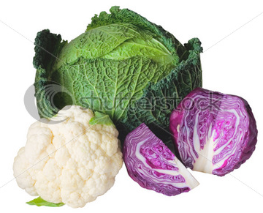
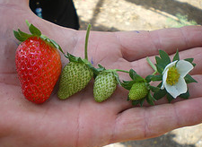
Almost all other crops…
never existed in nature in their present form.
They were created by humans using Artificial Selection!

Slide 19
Peppers bred for various traits.

Slide 20
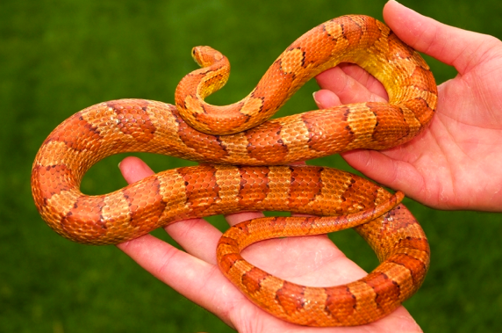
Your pets have been Selectively Bred.
Varieties of the Corn Snake
Nature’s Type:

Slide 21
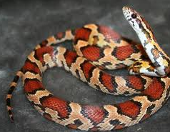
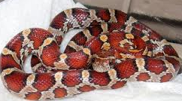
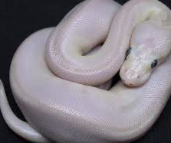
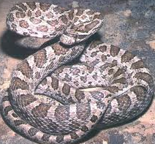
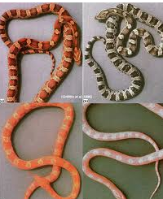
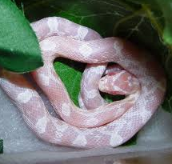
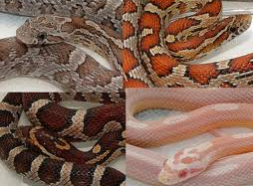
Corn Snakes for Sale

Slide 22
Selective Breeding
…is one way that humans have manipulated Nature for our benefit.
Natural Selection works in the exact same way, only Nature Selects which organisms get to reproduce.

