Slide 1
Bird Identification Practice
September 2010

Slide 2
www.allaboutbirds.org
Under the “Bird Guide” tab, click on “browse by name and shape”
Use size and shape to help you identify the following birds.

Slide 3
Number a blank piece of paper 1-15.
Write down the name of each bird next to the corresponding number.
Good luck!

Slide 4
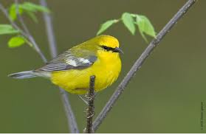
#1

Slide 5
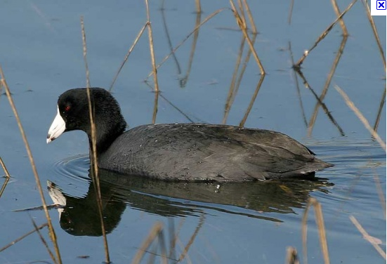
#2

Slide 6
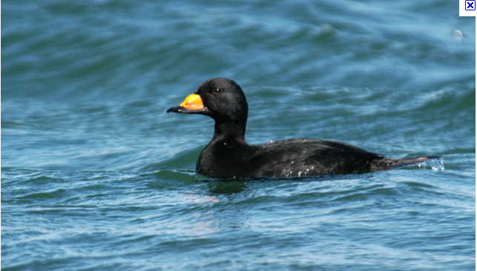
#3

Slide 7
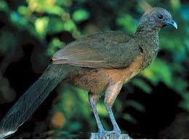
#4

Slide 8
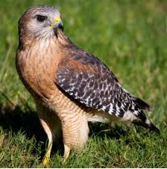
#5

Slide 9
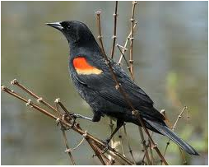
#6

Slide 10
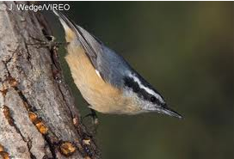
#7

Slide 11
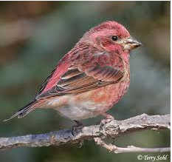
#8

Slide 12
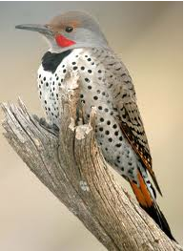
#9

Slide 13
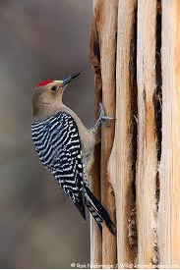
#10

Slide 14
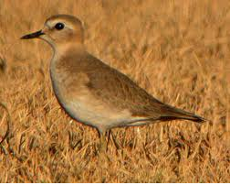
#11

Slide 15
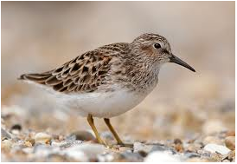
#12

Slide 16
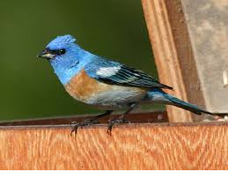
#13

Slide 17
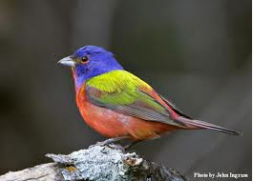
#14

Slide 18
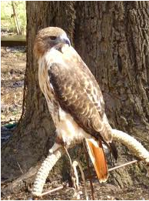
#15

