Slide 1
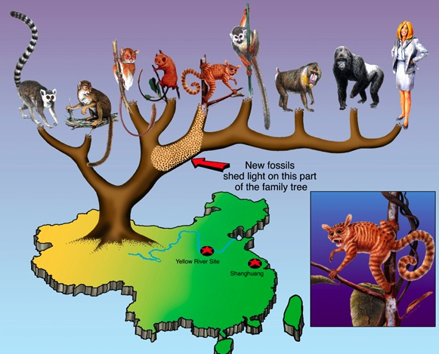
The Development of the Theories of Evolution and Natural Selection
Mr. Erdosy
Cedar International School
2009-2010

Slide 2
The Voyage of The HMS Beagle
In 1831, a 22 year old man set sail on the HMS Beagle for a 5-year journey around the world.
His job was to be the ship’s naturalist, collecting specimens from exotic places and shipping them back to England for study by scientists.

Slide 3
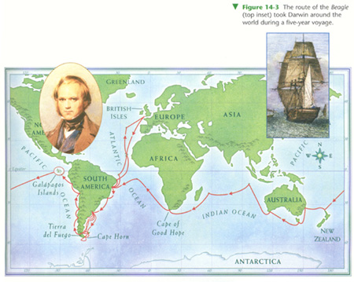
The Voyage of the Beagle

Slide 4
A ship’s Naturalist
At this time, the only way to study creatures in other parts of the world was to have someone go there, catch them, and send them home.
Almost all of the creatures found by a ship’s naturalist in those days was entirely new to science!

Slide 5
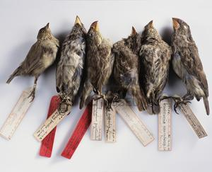
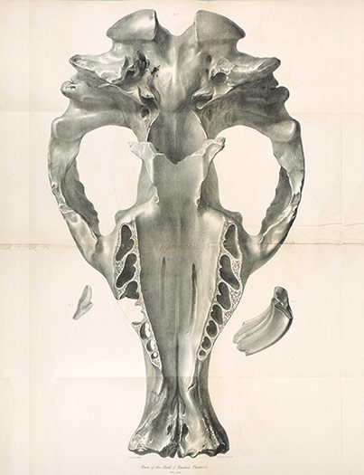
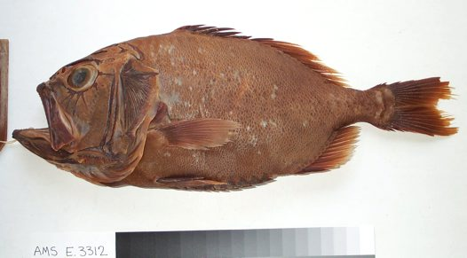
What did Darwin collect?

Slide 6
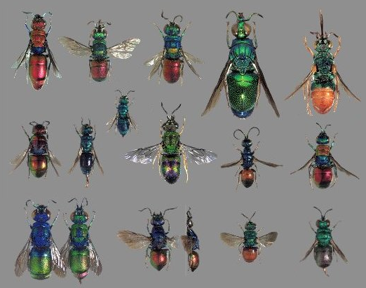
What else did he get?

Slide 7
Darwin and the Galapagos Islands
These islands are geographically isolated, which means they are very, very far from any other land.
Despite this isolation, there are thousands of species on these islands.
Almost all of them are UNIQUE to the Galapagos.

Slide 8
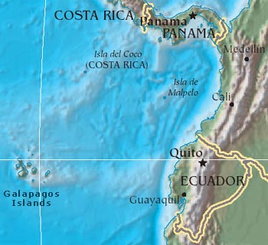
Galapagos Islands

Slide 9
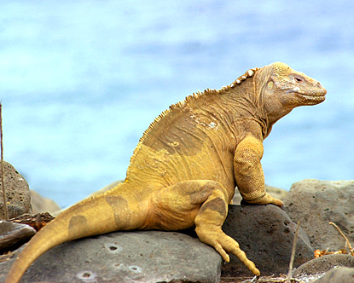
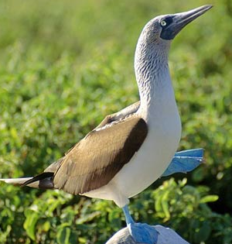
Creatures of the Galapagos

Slide 10
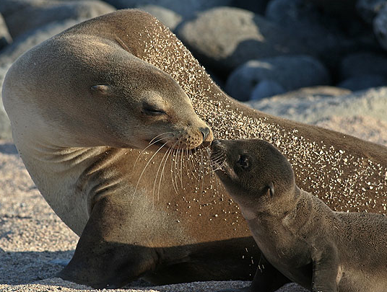
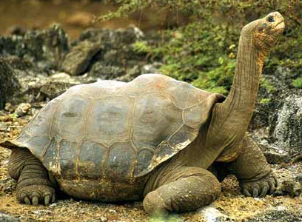
Creatures of the Galapagos

Slide 11
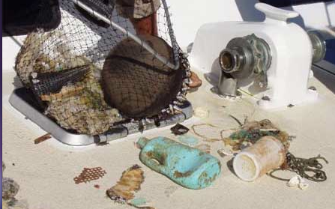
How did they get there?
Storms and other events often sweep creatures out to sea.
These creatures grab on to floating debris for survival.

Slide 12
What happened to them when they got there?
Somehow, some way, these creatures changed into new forms over thousands of years.
They now appear different than how the original member of their species appeared when it made it to the island!

Slide 13
From this…

Slide 14
To this!

Slide 15
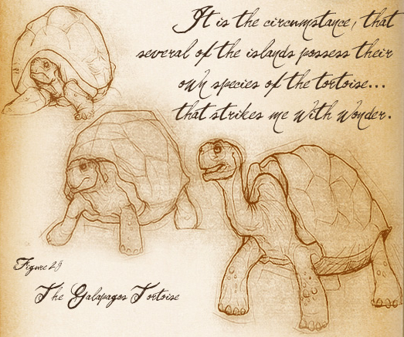
What did Darwin think of all of this?
He sat on this information, and mulled over his ideas in his journals for 15 years, telling almost no-one!
Until he got a letter in the mail…

Slide 16
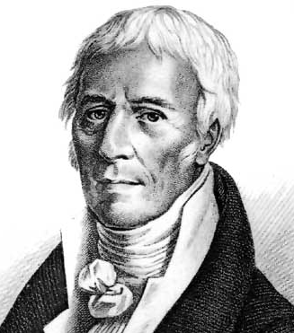
Alfred Russel Wallace
...was a big fan of Darwin and followed all of his work and letters.
Studying Darwin's notes, he soon began to have the same idea that Darwin had been wrestling with for more than 15 years...

Slide 17
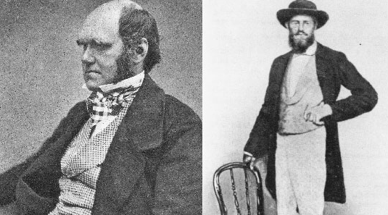
Wallace’s letter…
to Darwin explained the very same idea that Darwin had first!
They decided to present the idea together!
This idea was called Natural Selection.

Slide 18
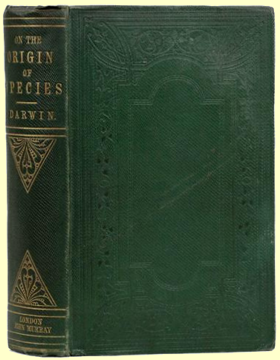
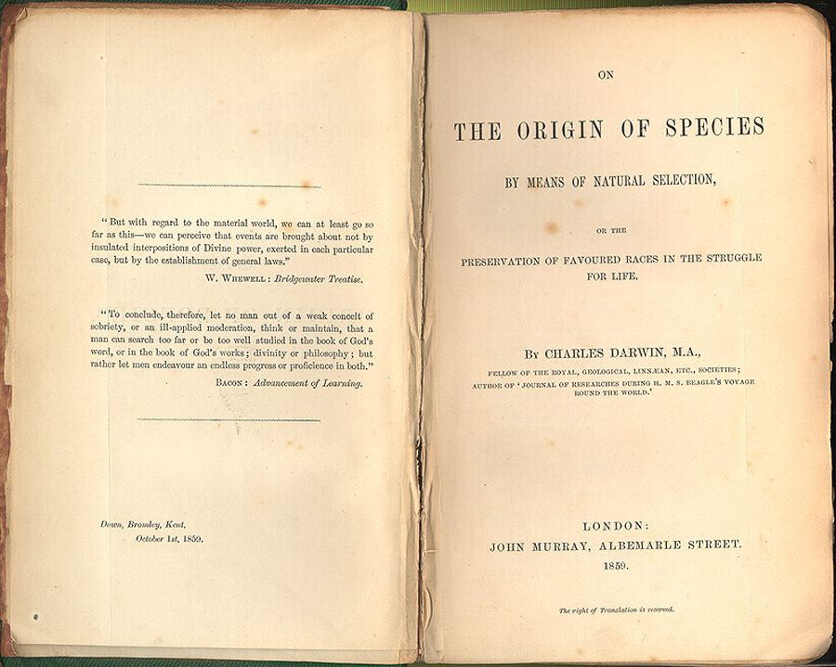
Darwin publishes his book first!
On the Origin of Species explained in great detail the force that Lamarck had thought about.
For this reason, Darwin is considered to be the father of Evolution by means of Natural Selection.

Slide 19
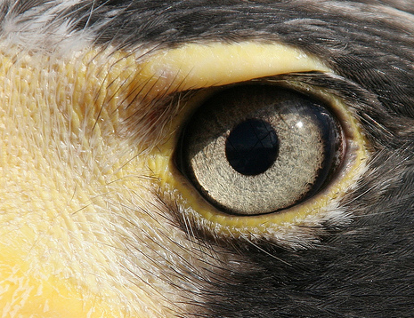
“The single best idea anyone has ever had.”
The ability of the theory of Natural Selection to explain and demonstrate evolution eventually led to it's widespread acceptance throughout the scientific community.

Slide 20
So…what exactly is it?
An analogy...
Small changes in a few thousand years...
It can also "go backwards"

