Slide 1
The Nature of Scientific Inquiry
How Science Works
Cedar International School
Mr Erdosy
2010-2011

Slide 2
So many questions…
The ancestor of science is ignorance.
Asking a question about the world around you is the first step away from ignorance and towards understanding.
Science is the tool used to understand how the world works.

Slide 3
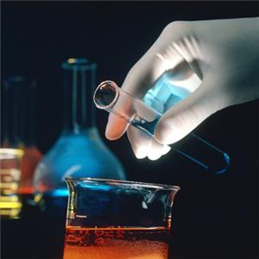
Answering your question…
What you think the answer to your question may be is called a HYPOTHESIS.
The hypothesis is then tested to see if it is correct.

Slide 4
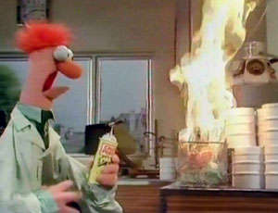
If it is wrong…
Go back to the drawing board and formulate another hypothesis!
You have still learned something if your hypothesis is rejected. This is not a bad thing.

Slide 5
Hypothesis
If it is correct, it is next retested in many different ways and formats, using different experiments, to see if it continues to be correct.
If the hypothesis is continually correct, under many different circumstances, experiments, trials and formats, it becomes a THEORY.
Essentially, a scientific theory is true.

Slide 6
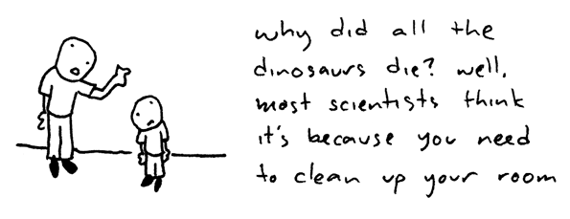
Scientific THEORY
- A well-tested EXPLANATION for a wide range of observations or experimental results.

Slide 7
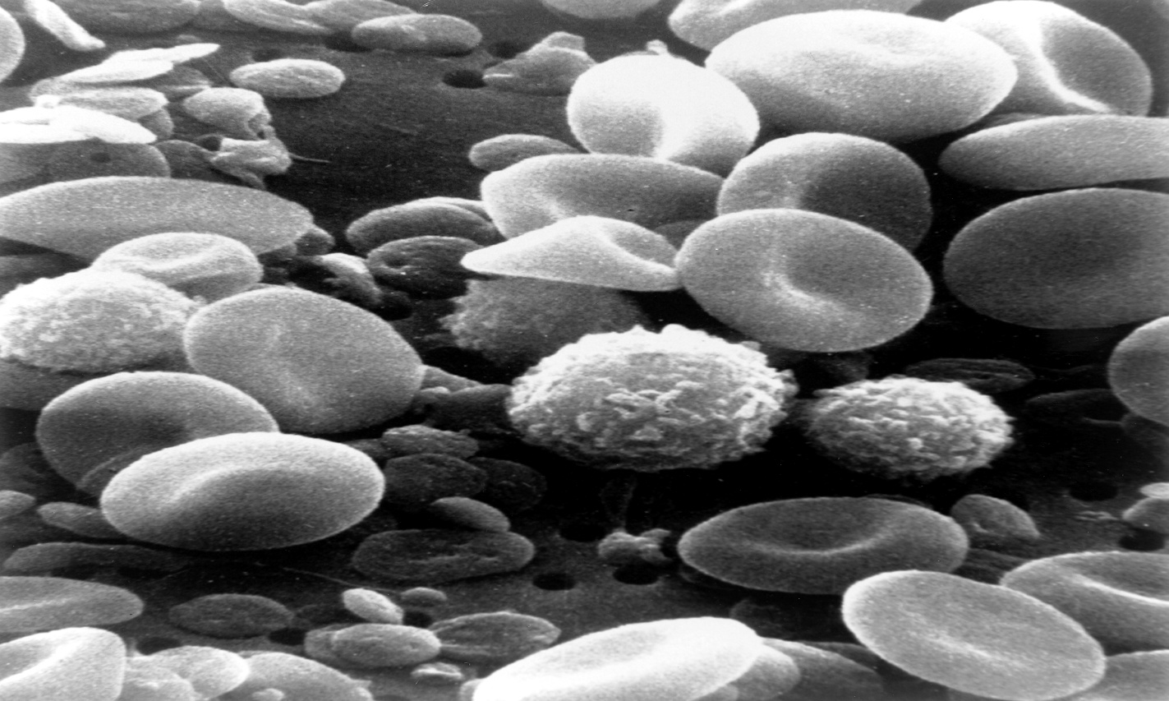
Cell Theory
Every living thing ever found is made of at least one cell.

Slide 8
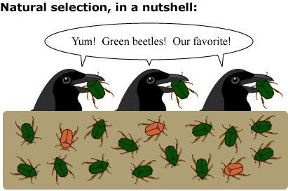
Theory of Natural Selection
Populations of organisms are changed through interactions with other organisms and their environments, leading to speciation.

Slide 9
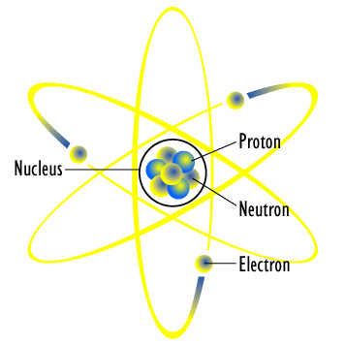
Atomic Theory
All matter is made of tiny particles called atoms.

Slide 10
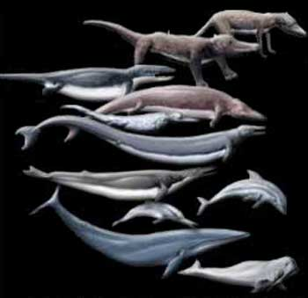
Theory of Evolution
Organisms have descended from common ancestors.

Slide 11
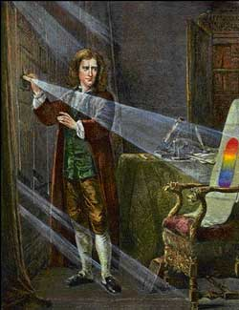
Scientific Laws
Scientific Laws are statements about the Universe , usually involving a mathematical constant. They are very specific.

Slide 12
Examples of Scientific Laws
Archimedes's Principal: Any floating object displaces its own weight of fluid.
Newton’s Laws of Motion, Universal Gravitation, Law of Cooling, etc.
Einstein’s E = mc^2, etc

Slide 13
Differences between Laws and Theories
Newton's law of universal gravitation states that every massive particle in the universe attracts every other massive particle with a force which is directly proportional to the product of their masses and inversely proportional to the square of the distance between them.
Theory of Gravity: All objects with mass attract each other due to the curvature of space-time.

Slide 14
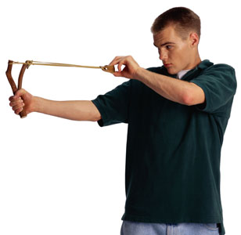
How are Theories and Laws like Slingshots and Automobiles?
A scientific law is like a slingshot. A slingshot has but one moving part--the rubber band. If you put a rock in it and draw it back, the rock will fly out at a predictable speed, depending upon the distance the band is drawn back.

Slide 15
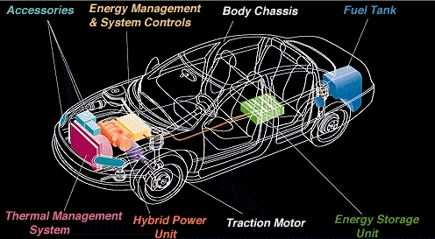
A theory is like the automobile. Components of it can be changed or improved upon, without changing the overall truth of the theory as a whole.

Slide 16
The Nature of Science
Any Theory or Law can, at any time, be proven false by new evidence or experimental results that contradict it.
If this happens, the Theory or Law is then adjusted to fit the best available evidence at the time.

Slide 17
Peer Reviewed
Science is Peer Reviewed!
This means that scientists check each others’ work continually.
This is also why experiments must be repeatable.

Slide 18
For example, if you say you have conducted an experiment that allowed you to turn a handful of sand into a fully functional human brain….cool. But… if this is not repeatable it is as if it never happened.

Slide 19
Think of science as one big math test that gets passed around a classroom full of experts in math.
They check each others’ work, repeat each others’ calculations and argue if any differences arise.
The accepted answers to each question become Theories or Laws.

